Slide 1
To replace with my own drawing

Slide 2
CSS143 Computer Programming (II)

Slide 3
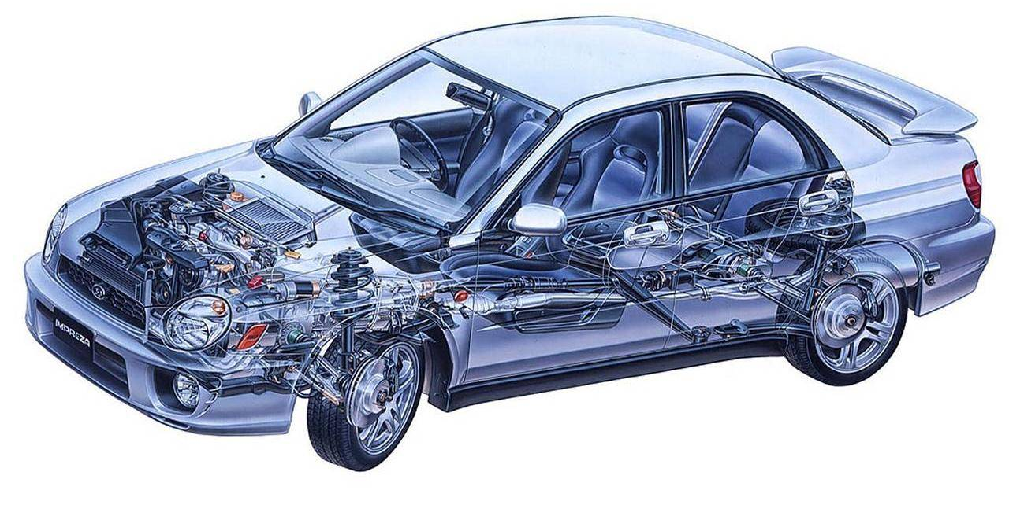
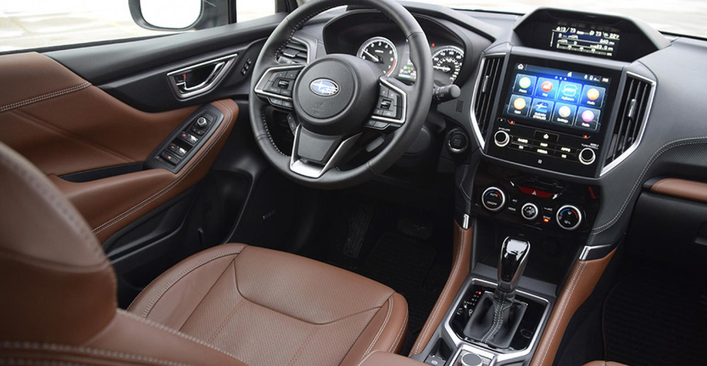

“Interface vs Implementation”

Slide 4
ADT
Abstract Data Type
Interface
Implementation
Public Access

Slide 5
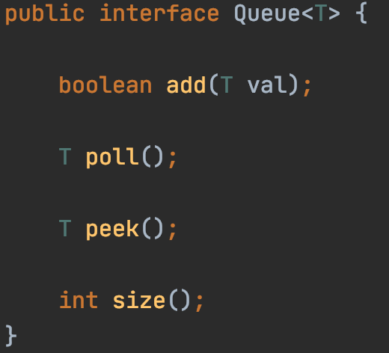
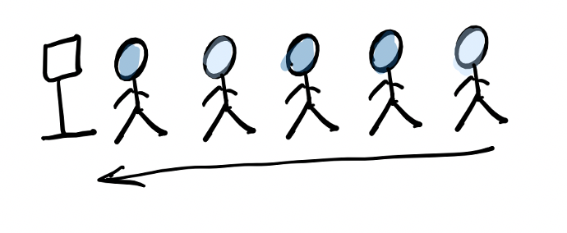
ADT: Queue
First In First Out (FIFO)

Slide 6
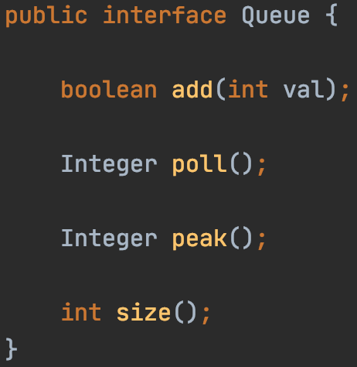

ADT: Queue
Interface
Implementation

Slide 7
ADT: Queue
Array
12
12
1
7
18
10
3
(Single) Linked List
head
12
12
12
1
7
18
10
3
null
Interface
Implementation

Slide 8
ADT: Queue
List
Array
12
12
1
7
18
10
3
(Single) Linked List
head
12
12
12
1
7
18
10
3
null
Interface
Implementation

Slide 9
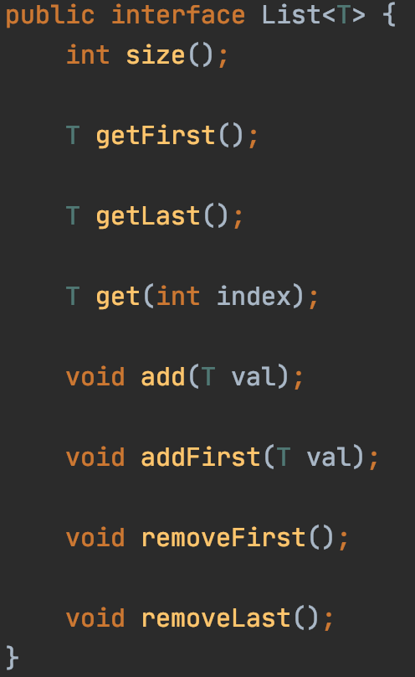
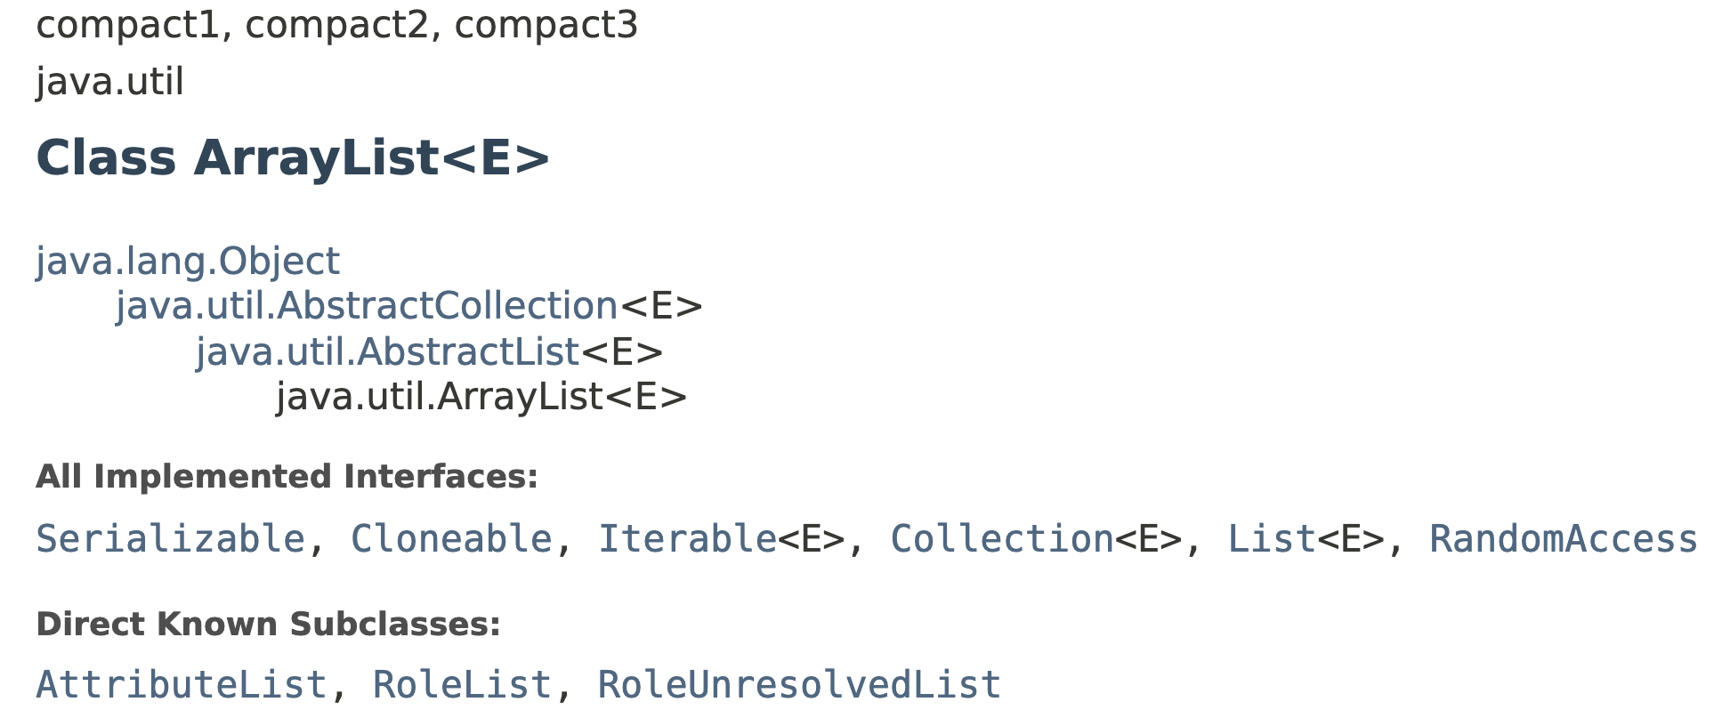
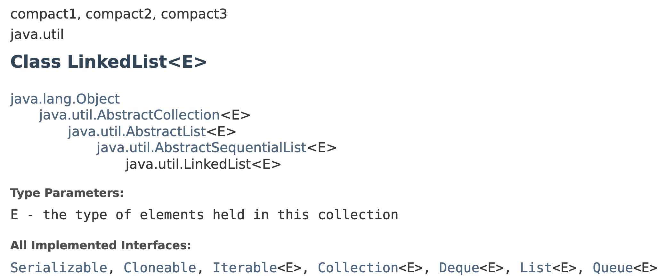
ADT: List

Slide 10
ADT: List
12
12
1
7
18
10
3
(Single) Linked List
head
12
12
12
1
7
18
10
3
null

Slide 11
ADT: List
array
list
Memory space

Slide 12
Array vs List
Array:
Fast random access
Fixed size
12
12
1
7
18
10
3
head
12
12
1
7
18
10
3
null
LinkedList:
No random access
Size not fixed
Fast insertion

Slide 13
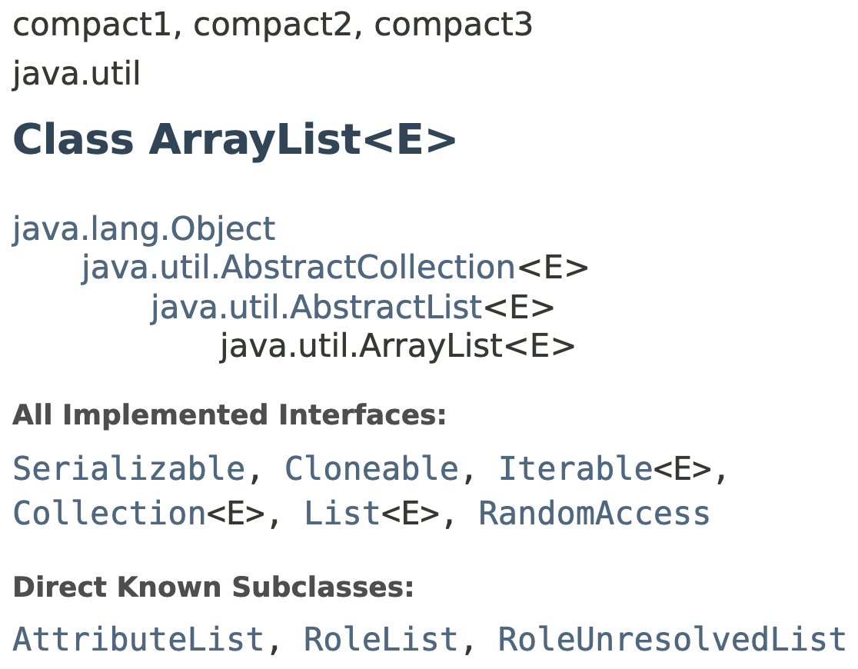
java.util ArrayList<E>
A list based on array
Constant time: get(int index)
Linear time: add(int index, E value)
Dynamic size aka auto-resizing

Slide 14
java.util LinkedList<E>
A list based on (double) linked list
Constant time: add(int index, E value)
Linear time: get(int index)
Dynamic size, aka auto-resizing

Slide 15
java.util ArrayList<E>
A list based on array
Constant time: get(int index)
Linear time: add(int index, E value)
After add(0, 1)
1
After add(0, 2)
2
1
After add(0, 3)
3
2
1

Slide 16
ArrayList vs LinkedList in Performance
java.util ArrayList<E>
Linear time: add(int index, E value)
Constant time: get(int index)
Dynamic size aka auto-resizing
java.util LinkedList<E>
Constant time: add(int index, E value)
Linear time: get(int index)
Dynamic size, aka auto-resizing

Slide 17
Performance Validation
add(0, val)
Linear time
head
null
add(0, val)
Constant time

Slide 18
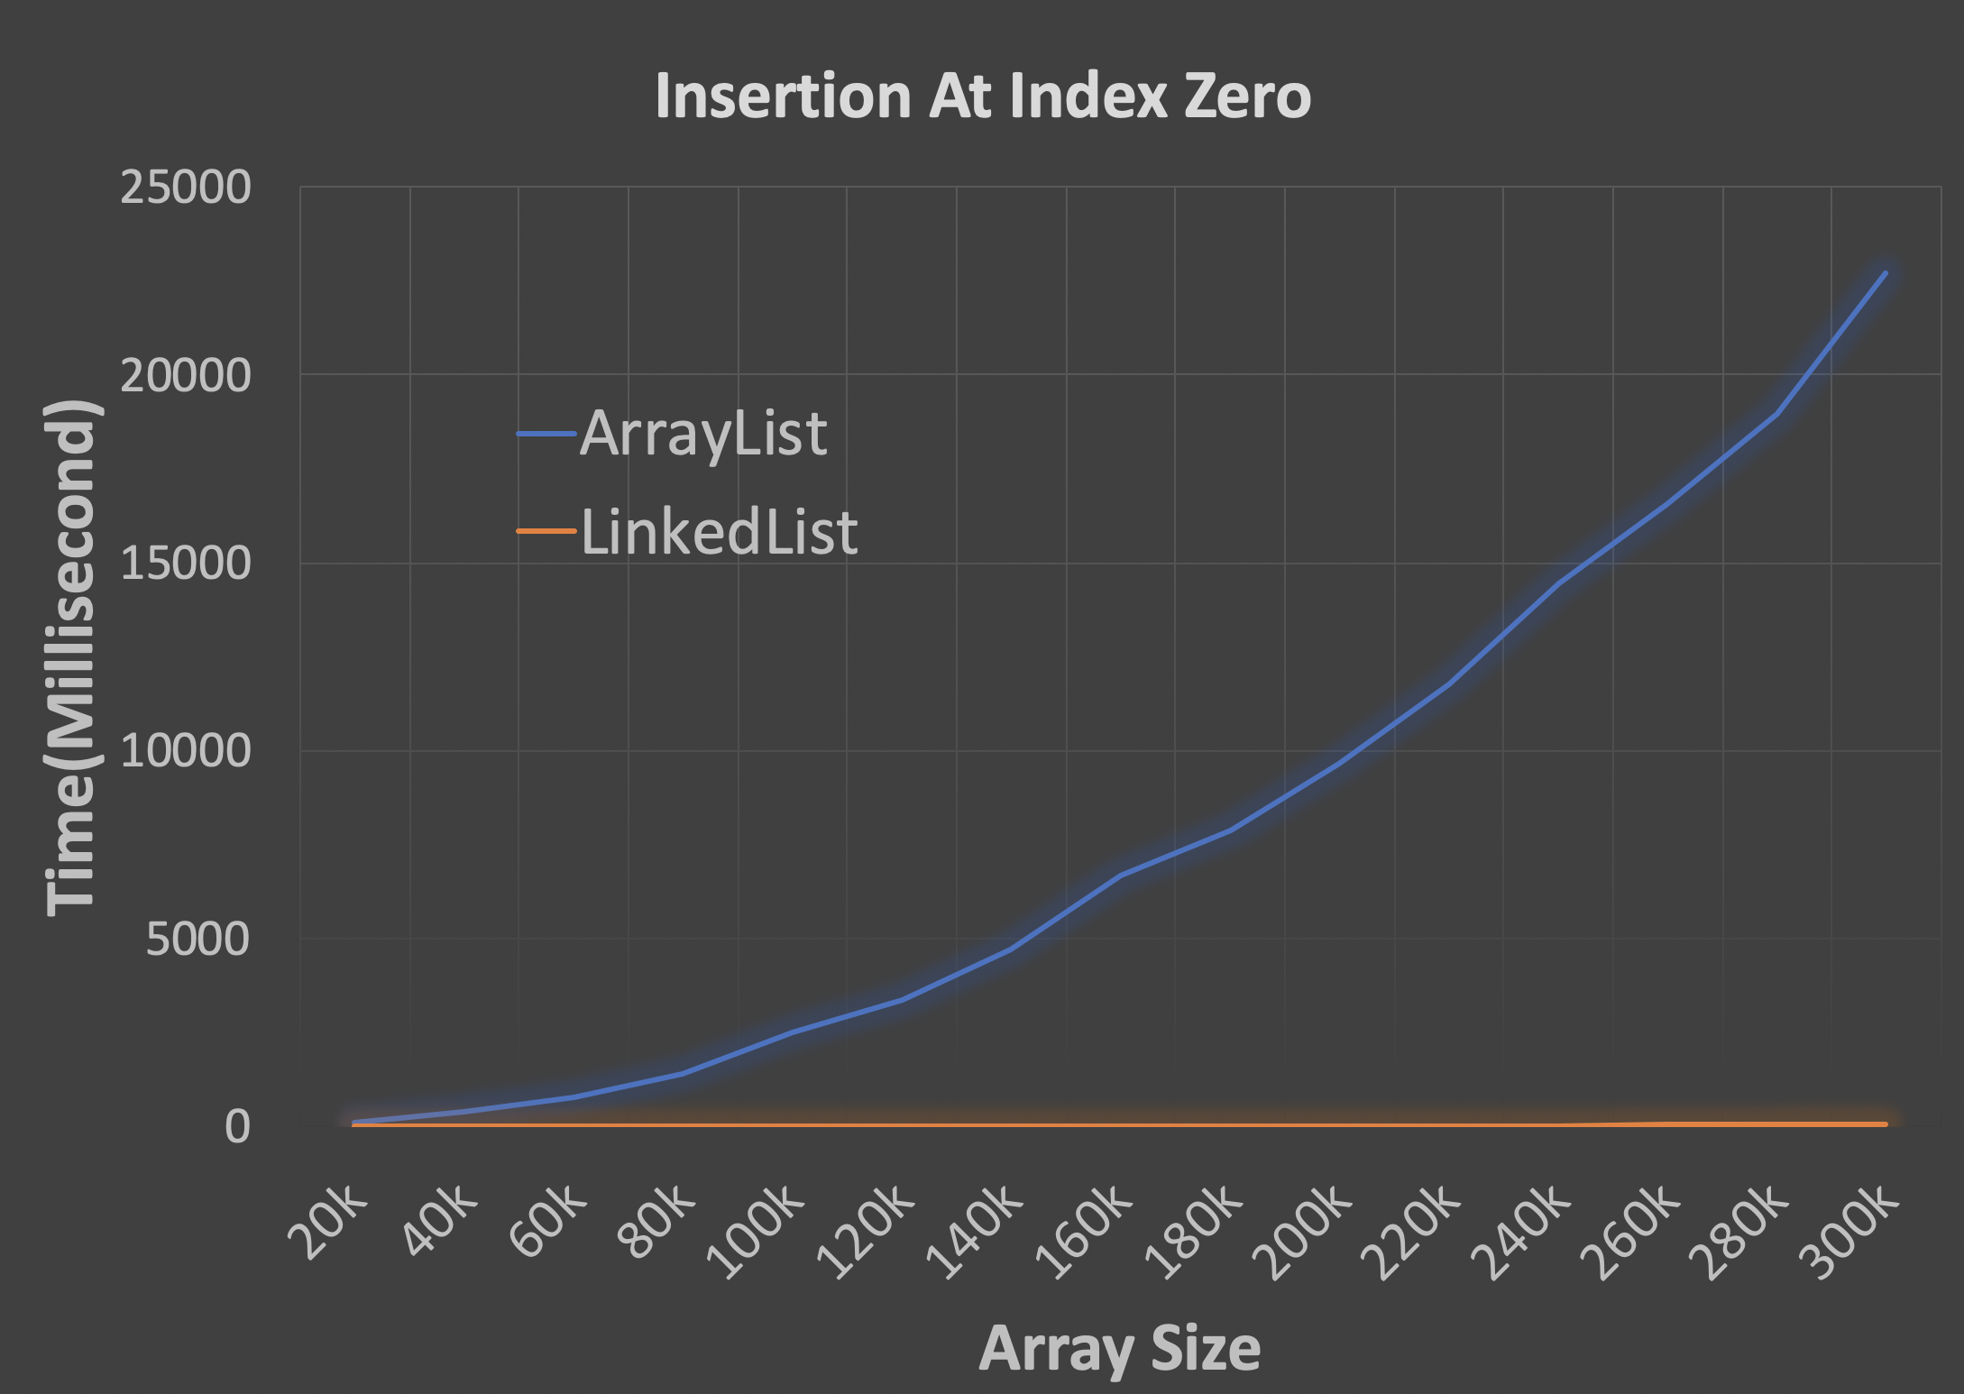
Performance Validation

Slide 19
Sounds familiar?
1
2
2
3
4
5
head
1
2
2
3
4
5
null

Slide 20
Queue ADT
poll()
12
12
12
1
7
18
10
3
12
1
7
18
10
3
add(…)

Slide 21
Stack ADT
push(…)
12
12
12
1
7
18
10
3
12
1
7
18
10
3
pop()

Slide 22

Stack ADT
push(…)
pop()
push(…)
pop()
First In Last Out (FILO)

Slide 23
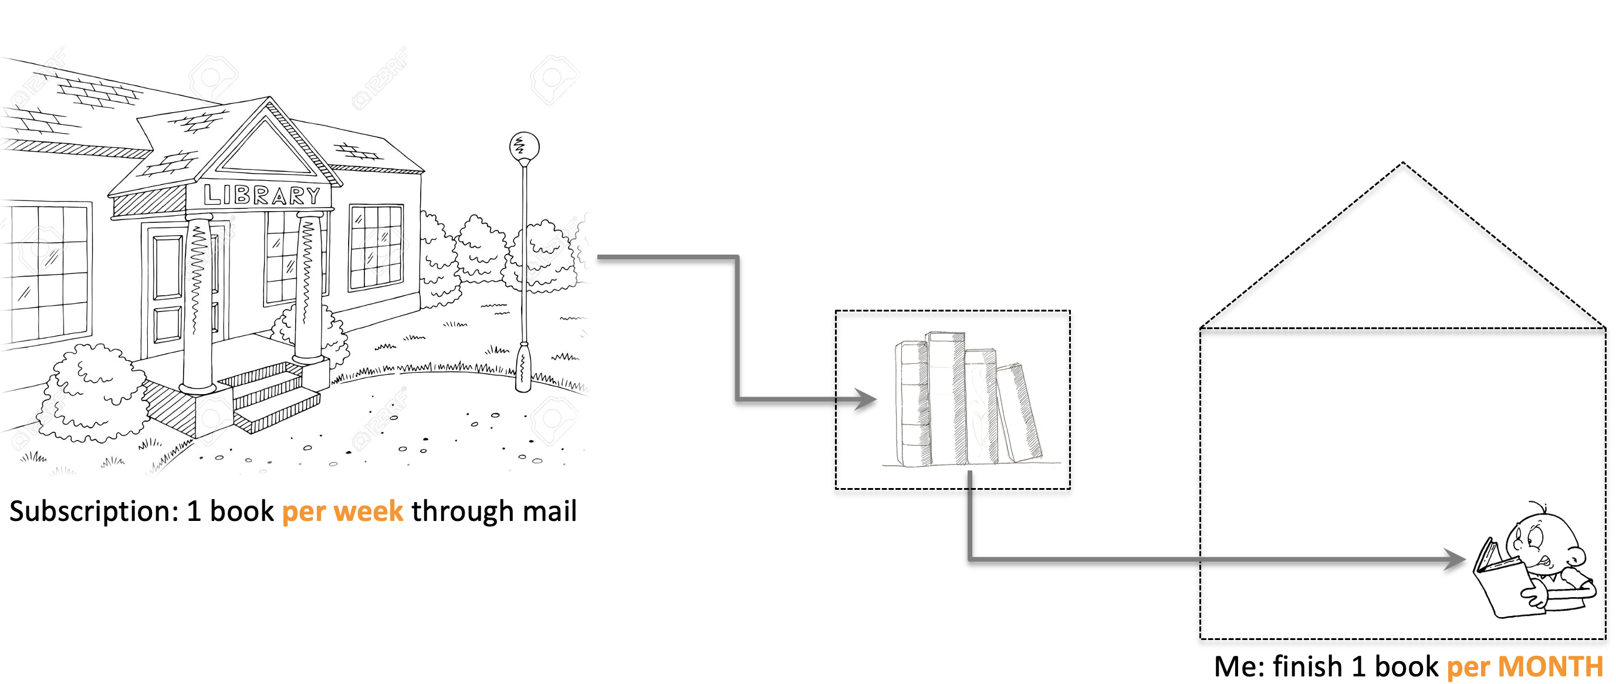
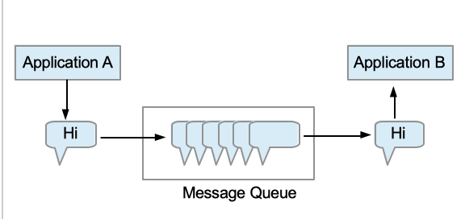
Applications
Queue
allows working at different speeds

Slide 24

Applications
Stack?
How do you watch all of these ?

Slide 25



Stack Application
Episode 1
Episode 2
Episode 3
Episode 1
Episode 2
Episode 1

Slide 26
Stack Application
Stack
Episode 1
Episode 2
Episode 1
Episode 2
Episode 3
Episode 1
Episode 2
Episode 1

Slide 27
Applications
Stack?
allows going back where we were

Slide 28
Exercise
Print linked list values backward
head
8
3
2
9
5
6
null
6, 5, 9, 2, 3, 8

Slide 29
head
8
3
2
9
5
6
null
6
5
Output:
9
6
5
9
2
3
8
2
3
8
Stack

Slide 30
Exercise
Validate Parentheses
“( ) [ ] { }”
“( [ ] )”
”( [ ( ) ( ) ] )”
“( [ ) ]”
“( ( x ) )”

Slide 31
Exercise
(
)
Validate Parentheses
[
]
)
]
)
“( ( ) [ ] )”
{
}
Stack
(
[
(

Slide 32
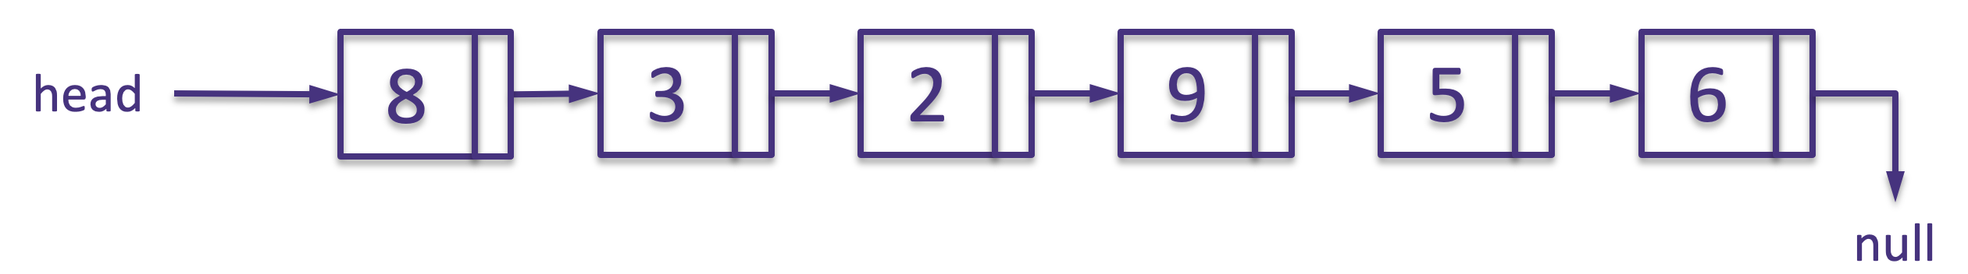
When to use Stack ADT?
”I’ll do something else first,
and then come back to continue”
Stack
Netflix watching
Print a linked list reversely
Validate parentheses
”( [ ( ) ( ) ] )”

Slide 33

Homework Review

Slide 34
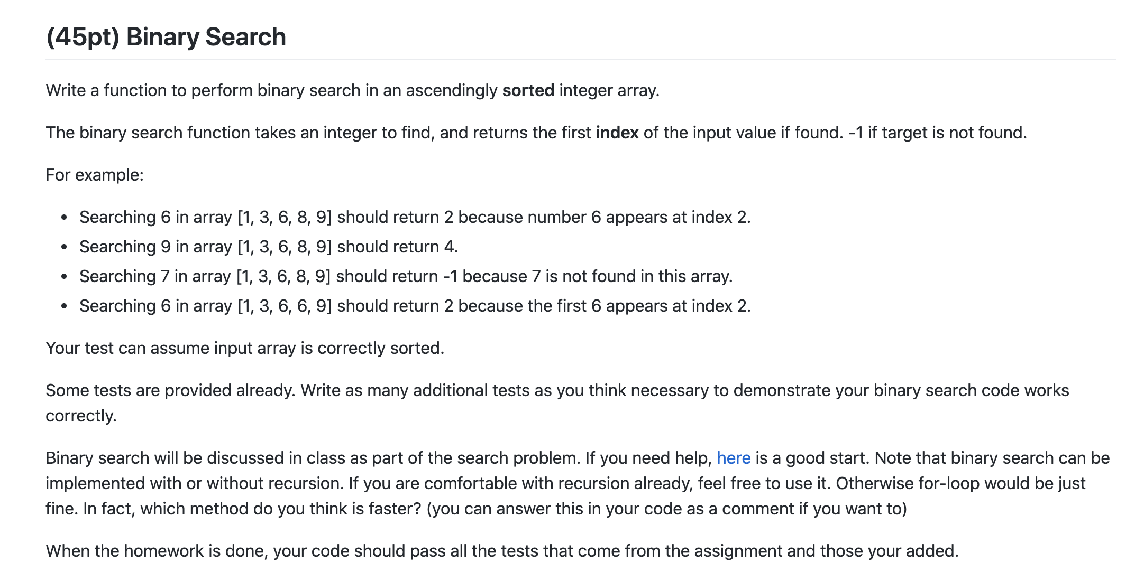
Homework 1
Target: 14
1
3
5
7
9
10
12
12
14
14
18

Slide 35
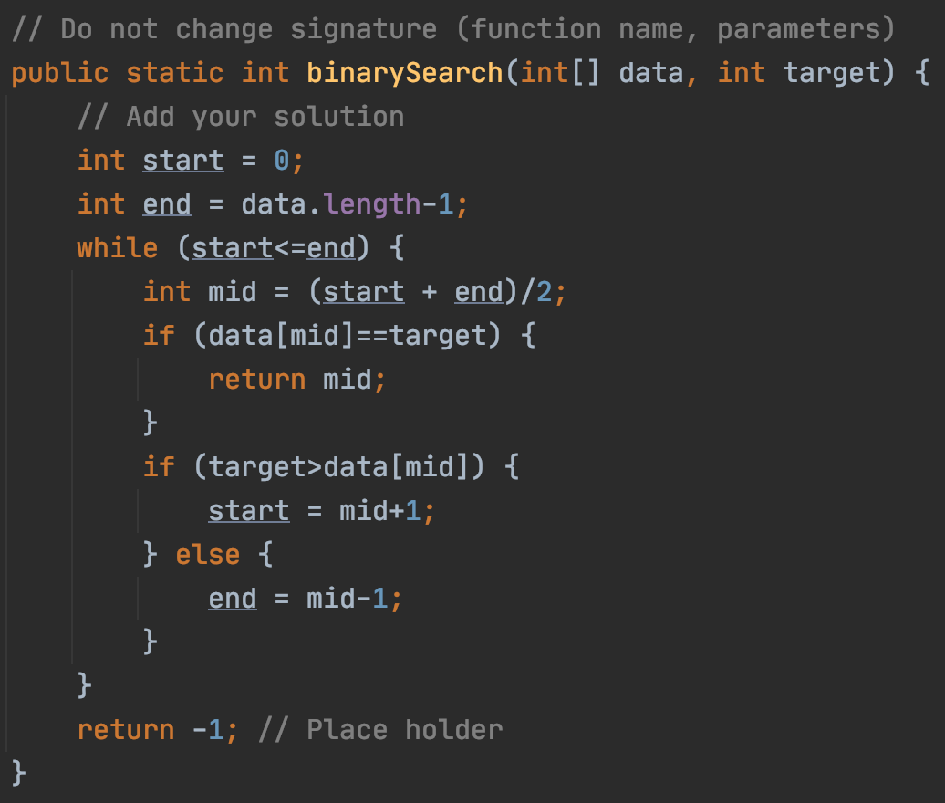
Homework 1 Review

Slide 36
Homework 1 Review
2147483647
Size: Integer.MAX_VALUE
Size: very large
array
Target 0
Target 1

Slide 37
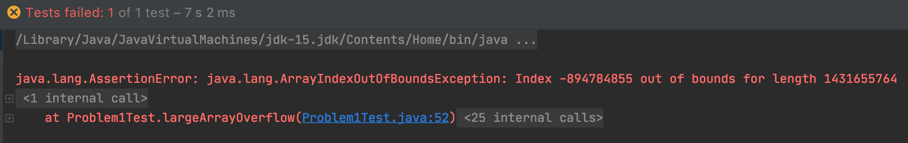
Homework 1 Review
Size: Integer.MAX_VALUE
Size: very large
array
Target 0
Target 1

Slide 38
Homework 1

Slide 39
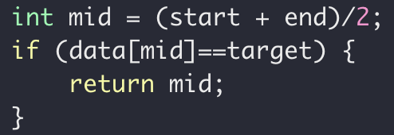
Homework 1 Review
Size: Integer.MAX_VALUE
array
start
mid
mid
end
start

Slide 40
Homework 1 Review
overflow
(start+end)>Integer.MAX_VALUE
Size: Integer.MAX_VALUE
array
start
end

Slide 41


What do you do when a bug is found and to be fixed?
Fix the bug in the function
2. Fix the bug in the function and add a test for it
3. Add a test first, see it fails,
then fix the bug in the function,
and see the test pass

Slide 42
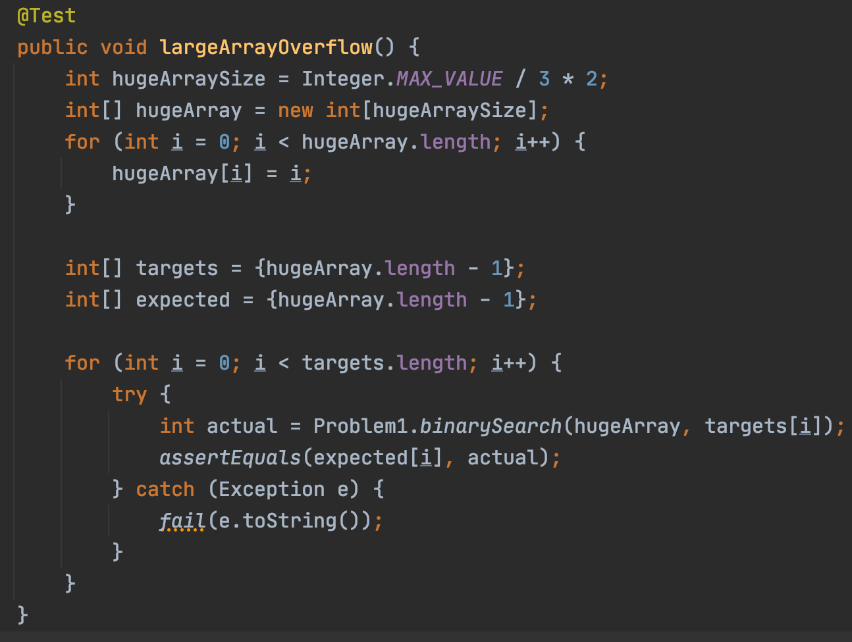
Add a new test

Slide 43
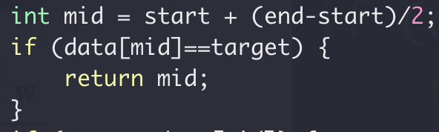
Homework 1 Review
Add fix

Slide 44
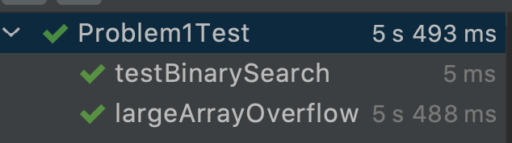
Add a new test
Old tests passed
New tests passed

Slide 45
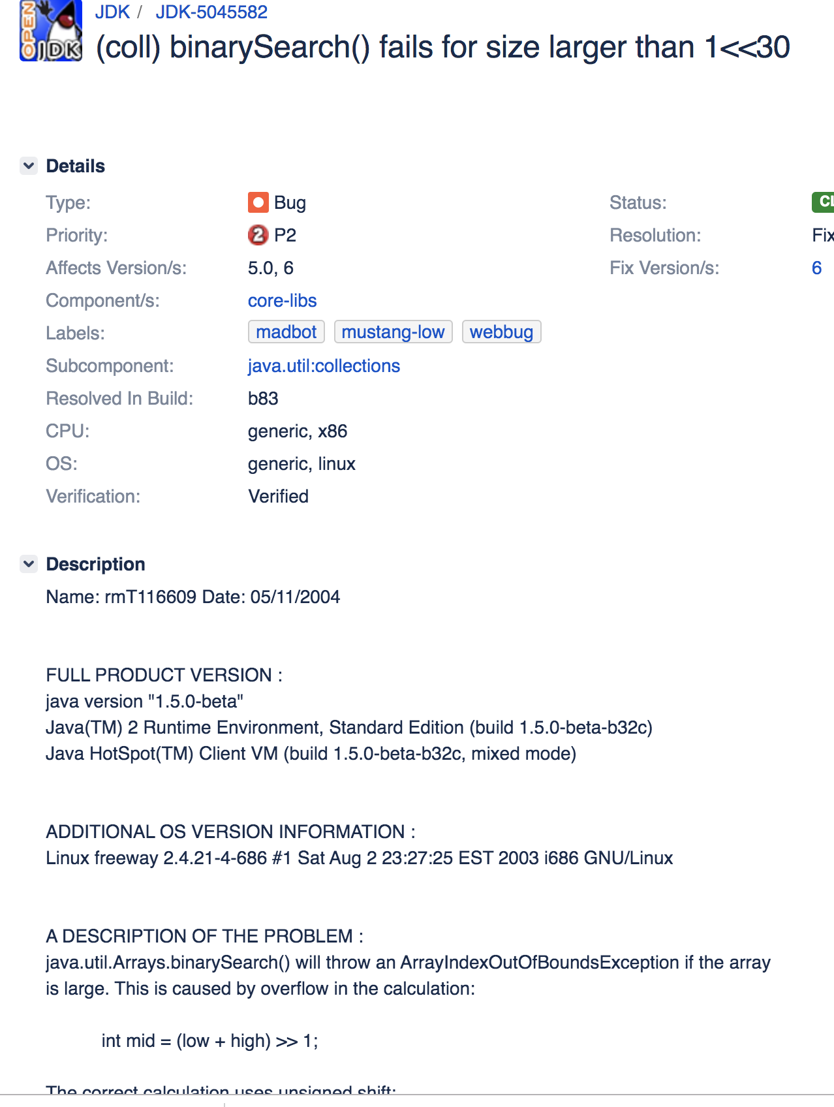
Homework 1 Review
https://bugs.openjdk.java.net/browse/JDK-5045582

Slide 46
Midterm Preview

Slide 47
Midterm Preview
Java Basics
Array
Loops
Etc.
https://github.com/pdgetrf/code-along-reverse-array
https://github.com/pdgetrf/code-along-max-number
Java OOP
Encapsulation
Constructor, copy constructor, setter, getter
Inheritance
Class, base/derived class, abstract class, interface
Metamorphism
Late binding
Override vs Overload
https://github.com/pdgetrf/OOBPet.git

Slide 48
Midterm Preview
Abstract Data Type
Interface vs Implementation
Queue, Stack
When to use
Implementation
Linked list vs array
Circular array
Resizing
https://github.com/pdgetrf/array_queue
Linked list
Performance comparison with Array for various access pattern
Read
Insert/delete
Circle in a linked list

Slide 49
Code to review
https://github.com/pdgetrf/code-along-reverse-array
https://github.com/pdgetrf/code-along-max-number
https://github.com/pdgetrf/OOBPet.git
https://github.com/pdgetrf/array_queue.git
Some of these have multiple branches. Make sure to review them all.

